Slide 1



24th International Summer School 2022:
Digitization, Artificial Intelligence and Responsibility of Sciences
An Old or New Hegemony? The International Perspective on Digitalization of the Economy
Dr. Rainer Engels

Slide 2

GIZ at a glance - selected business statistics (2020)
3,3 billion euros business volume
508 million euros in cofinancing
23,614
staff members worldwide
Including
> 75 % EU cofinancing
59.2 %
percentage of women in the workforce*
Including 15,988 national staff
We operate
in Germany and in around
120
countries worldwide
6/29/2022
Notes:
Dear participants, as I am working for GIZ, I would like to start with a very short introduction into what GIZ is all about. GIZ is a German government-owned company that implements most of the projects of German development cooperation with partner countries. As at 31 December 2020, GIZ had precisely 23,614 employees. Of this total, 5,007 worked in Germany. Almost 70 per cent of employees (15,988 people in all) were national staff in the countries in which we operate. They are recruited and contracted in these countries. Women accounted for 59.2 per cent of our total workforce. Worldwide, GIZ operates in 120 countries. In Germany it has six bases in addition to the registered offices in Bonn and Eschborn. One of them in Berlin. In 2020, our business volume was 3,3 billion euros. Our most important commissioning party is the German Federal Ministry for Economic Cooperation and Development (BMZ), which accounted for almost 2,7 billion euros of our income in the public-benefit business area.

Slide 3
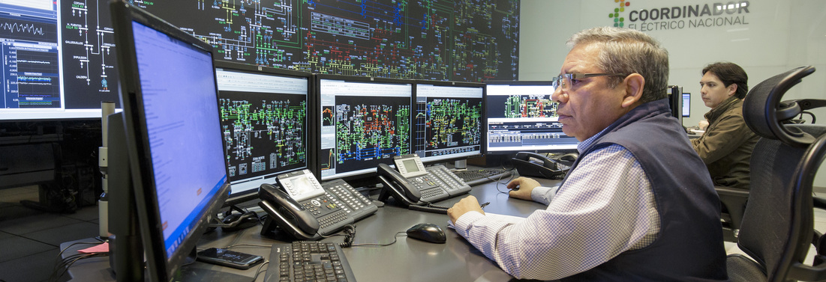
Intro
Notes:
In the fourth industrial revolution has begun and will be essentially completed in the most developed industrial countries by 2035. According to the progress report of the Plattform Industrie 4.0 (2020), 59 percent of German industrial companies with more than 100 employees already use Industry 4.0 applications. In the course of Industry 4.0, 73 percent of companies would not only change individual processes, but entire business models. The COVID-19 virus has not slowed down this development but accelerates it – because digitization allows us to better deal with the crisis and get out of it faster. The fourth industrial revolution is characterized by comprehensive digitization and networking of all production stages up to self-learning self-organization in a company (machine learning, artificial intelligence, Internet of Things). The impact will be profound and far-reaching and has the potential to fundamentally change the way in which the production and consumption of goods and services across the entire value chain and the entire product life cycle are shaped economically, socially and culturally in many regions of the world. In its 2016 research report, the Institute for Employment Research (IAB) expects Germany to lose around 1,500,000 jobs by 2025, but this is offset by the expected creation of around 1,500,000 new jobs. However, the employees who lose their jobs are only partially qualified for one of the new jobs. Thus, even in an economically successful industrial state, disruptive change requires enormous adjustment efforts. On the other hand, there are countries and regions that do not have the appropriate technological basis, educational and university structures, the necessary investment capital or involvement in R&D networks. This applies in particular to sub-Saharan Africa, but also parts of Latin America or Central and South Asia. But even for emerging markets, it has now become apparent that they can hardly keep up and are being left behind again after a phase of catching up development. Therefore, everywhere the consequences of the digital development can lead to (intensifying) existential crises.

Slide 4
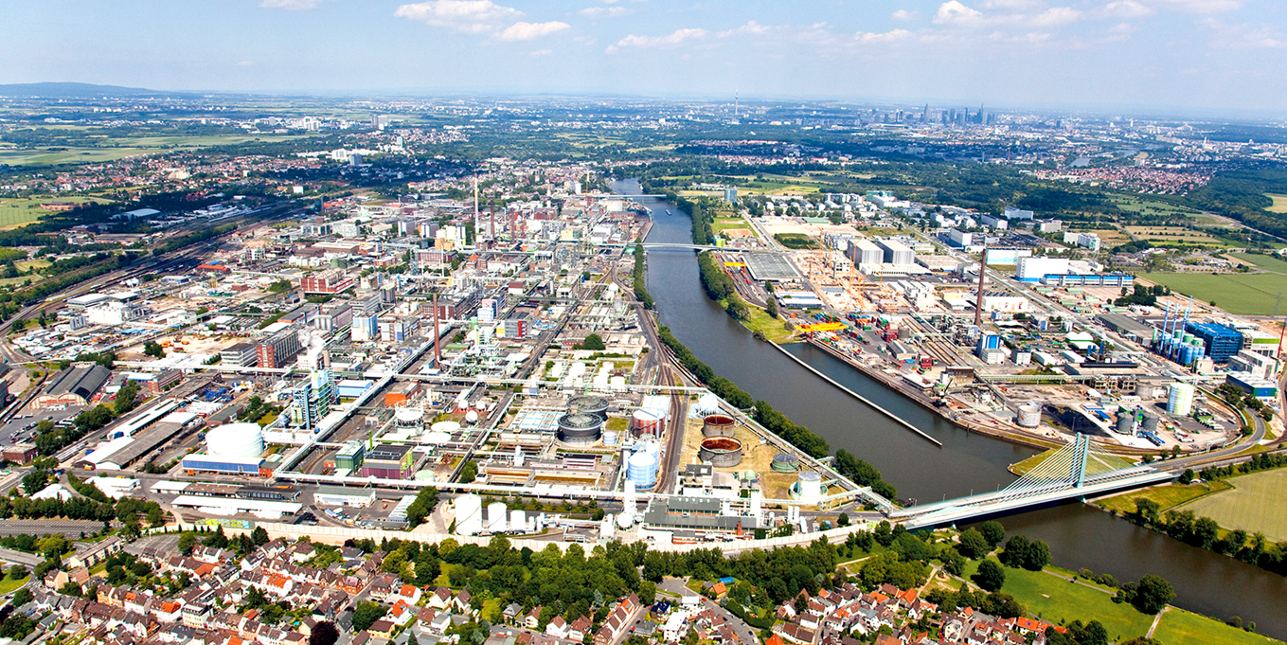
Thesis 1: The introduction of „Industry 4.0“ is a disruptive process
Notes:
Thesis 1: The introduction of “Industry 4.0” is a disruptive process
Wherever complex production processes prevail, digitalization, which has been further developed into Industry 4.0 through networking and artificial intelligence, will prevail. To a lesser extent, this also applies to services. Why is this development so attractive for companies and governments the like? For companies, the much higher effectiveness and productivity, and at the same time flexibility is highly attractive. Lot size one is the buzzword, Production lines can now produce very personalized and individual products instead of thousands of the same, without extra kosts. Digitalization also allows for reducing costs and risks and at the same time increasing margins. That makes the platform economy so attractive. Industrial automation is one of the world's most dynamic growth markets. For example, about 30% of German mechanical engineering products are already software or automation technology. At the heart of this technology push are the automation of increasingly complex work tasks and new intelligent production processes that are networked with each other, exchange information and are partly capable of learning (Internet of Things in combination with artificial intelligence). Especially in Germany, this view is generally shared in the economy. However, this is not an evolutionary development of computerization and automation, but a revolutionary, disruptive development. Due to the exponentially increasing number of sensors, the digitization of potentially all things and their networking with each other and with people, the digital control of the entire economic process across the entire value chain and thus from networked services over research & development to product design and marketing, to production, to recycling and disposal is made possible for the first time. Artificial intelligence (AI) could bring about a real leap in global productivity – a pillar of the 4th Industrial Revolution – with significant impacts on humanity and the planet, as significant as water vapor and electricity. There is great potential to generate societal benefits for human welfare, but the risks of harm are also high. In the worst case, it could be used for nefarious and destructive purposes. Which path is taken depends heavily on political decisions. Companies are challenged to develop new business models in order to remain competitive. For us as development workers, the question is: can developing countries profit from the new development, how can we support this and if the negative effects (e. g. on jobs) prevail, how can we buffer this and protect our partners from those negative effects.

Slide 5

Thesis 1a: To cope with the risks means to follow standards
Principles for Digital Development
Notes:
Standards in digitization are not considered technically (e.g. DIN), but in the broader sense as guidelines, voluntary commitments, standards, regulations (soft law), but also as laws and agreements (hard law) (of the partner governments), with which we lay down uniform specifications, guidelines or framework conditions for a social, ecological, sustainable, human-centered approach to digitalization. Standards are therefore of essential importance for the further development of digitalization in our partner countries and even in Germany.
Digital as a standard in development cooperation has been implemented at GIZ since 2017/18. The Digital Principles were ratified by GIZ in 2018 and thus provide the guidelines for all projects that use digital solutions.
The Principles for Digital Development are guidelines for achieving a sustainable impact of digital technologies in development programs. The BMZ wants to make digital development cooperation successful, efficient and effective. In order to follow guidelines for the planning and implementation of effective digital approaches, the state implementing organisations KfW and GIZ, among others, signed the commitment to the Principles for Digital Development of the Digital Impact Alliance (DIAL).
o Design with the User
o Understand the Existing Ecosystem
o Design for Scale
o Build for Sustainability
o Be Data Driven
o Use Open Data & Standards, Free Or Open Source Software & Open Innovation
o Reuse and Improve
o Address Privacy and Security
o Be Collaborative
For project preparation and implementation, basic principles such as "Do no harm" or "Leave no one behind" apply, also to digital solutions. In order to rule out unintended negative effects of digital solutions and exploit potential, GIZ has developed an internal "Safeguards and Gender Management System" that is also relevant for projects with regard to digitalization.
I will give some examples for digitalization projects later.

Slide 6
Thesis 2: On global level, jobs will get lost, especially in emerging markets
Notes:
Thesis 2: On global level, jobs will get lost, especially in emerging markets
Digitalization, networking and artificial intelligence tend to lead to poorly secured and lower-paid jobs (especially in the platform economies) and cause a massive change in job descriptions by increasing overall productivity, but especially in labor productivity. Simple work, but increasingly also more complex and creative workflows, are done by machines. At the same time, new, technically more demanding jobs are created, but usually not in the same number. In contrast to the transition from agrarian society to industrial society and the transition to a service society, the digital transformation affects all three sectors equally, so that – if no political countermeasures are taken – more and more jobs will be lost net. After the initially very negative forecasts by Frey & Osborne in 2013, there are also more differentiated voices from Boston Consulting to the Hans Böckler Foundation in recent times, which at least give the all-clear for industrialized countries in the medium term, such as the Market Economy Foundation, McKinsey and the World Bank Group. For developing countries, the situation looks bleaker and in the medium term, the previously promising emerging economies will suffer particularly well. It is also very important to realize that shifting work from one sector to another could be particularly difficult in labor markets of developing countries, such as India, which is experiencing massive labor market disruptions. Some examples of German development cooperation:
Artificial Intelligence (AI)
- =Government recommendations for value-based, sustainable standards for AI
- Project example FAIR Forward (SV/GV Digitalization): Supports several partner countries in promoting sustainable AI regulations and supporting local ecosystems by building competencies, identifying use cases and creating framework conditions.
- Among other things, Fair Forward is working to identify and counteract gender bias in artificial intelligence and machine learning.
- Examples: supporting the ethical AI framework in Uganda and Ghana or in the development of national artificial intelligence policy in the Republic of Rwanda.
Promoting fair work on digital platforms
- Project: Gig Economy Flagship (SV/GV Digitalization) promotes fair work in the gig economy / platform economy at the level of employees, platforms and important actors from politics, business and civil society.
- The Gig Economy Flagship promotes fair work on digital platforms while counteracting unfair practices. The flagship works closely with the Fairwork project founded by the Oxford Internet Institute, which evaluates digital job placement platforms against five principles of fair work through a global network of researchers in over 20 countries.

Slide 7
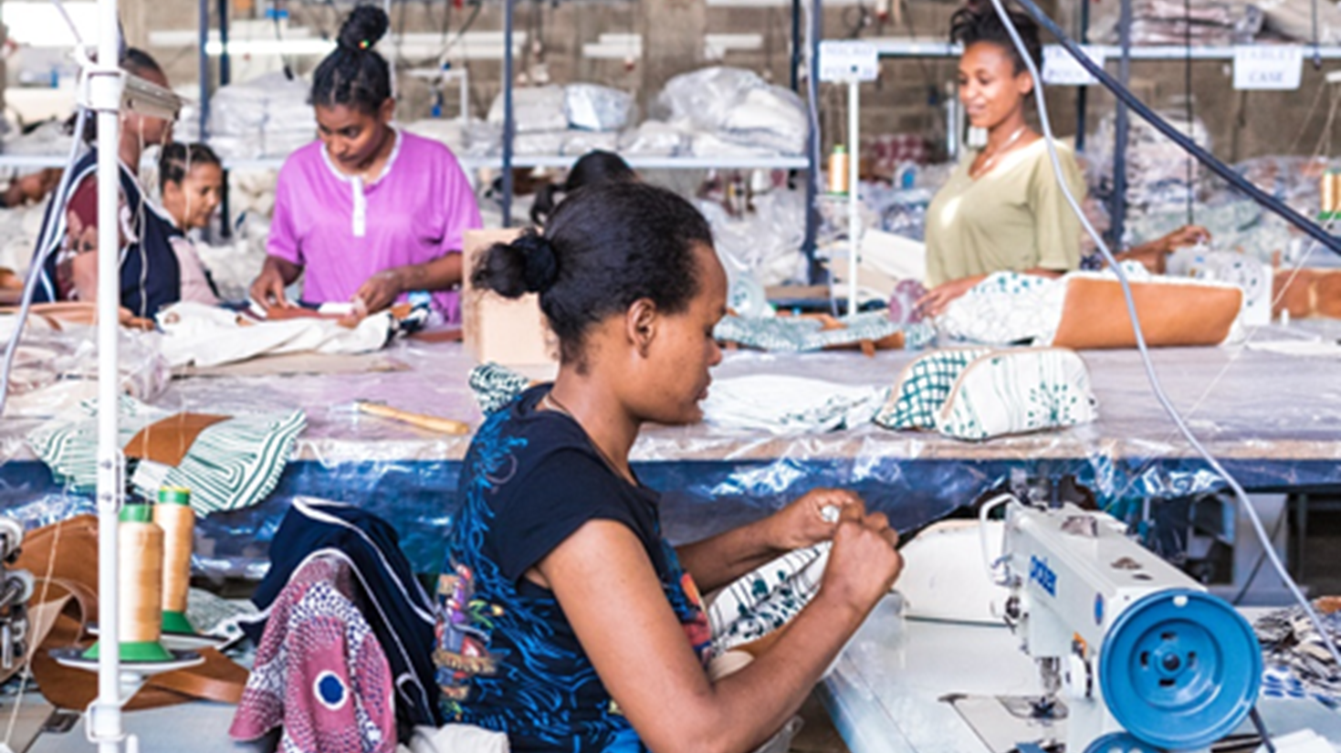
Thesis 3: Global value chains/delivery chains restructure themselves: Reshoring
Notes:
Thesis 3: Global value chains are restructuring themselves in the sense of reshoring
Under normal economic conditions, the international division of labour is the most efficient mode of production, provided that all factors of production are mobile. However, this is not true for the labour factor even in normal times and COVID-19 has shown that the resilience of the economy in crises also depends on the security of the ability to deliver and the openness of trade routes, so that a certain degree of regionalization and even re-nationalization can be rational. Digitalization can support this. McKinsey estimates this effect (after COVID-19) to be that – taking into account industrial economic decisions and national policy priorities – 16 to 26% of global goods exports worth US$2.9 trillion to US$4.6 trillion will change production countries over the next 5 years if companies restructure their supply networks. This is still quite inaccurate, but still in the midst of the COVID-19 pandemic, it is hardly to be expected otherwise. However, the order of magnitude exceeds exports from developing countries and will become highly relevant for them. Another figure reinforces this impression: 93% of the CEOs of leading companies in global value chains plan to increase resilience. A similar analysis is being carried out by the European Central Bank, which predicts a drastic transformation of global value chains in the next decade. As a result, the competitiveness of production sites worldwide is once again changing considerably. Production in industrialized countries is becoming competitive again, as the location factor labor costs loses importance and factors such as political and energy security (think about the new geopolitical developments with the Russian Ukraine war as a starting point) and, in particular, market/customer proximity gain relative importance. The relocation of production to emerging and developing countries will thus be reversed, at least in part (reshoring), as contract processing tends to lose importance. Short delivery routes and quality and safety considerations are becoming more important than reducing cost advantages, while risks remain the same, especially in poorer developing countries. Some partner countries might gain more bargaining power since the geopolitical changes took place, especially countries with resources or with strategic importance for trade routes.

Slide 8
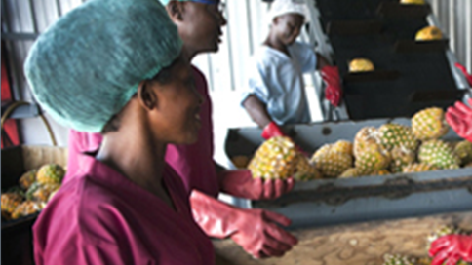
Thesis 4: Regional markets develop to be served by regional value chains
Notes:
Thesis 4: Regional markets emerge for regional value chains
However, individualized production and automation can also make regional production more efficient, so that it could pay off at locations close to wealthy customers, including in urban centers of developing and emerging countries. According to UNCTAD, it is not yet clear how digitalization will affect value chains, and whether these effects will always look the same. On the one hand, increasing digitalization could require less presence of the investor in the target country. On the other hand, there could be digital, more customer-oriented products & services closer to the customer. In any case, new players are emerging who no longer sell products, but provide services that are licensed. The involvement of local companies is therefore possible, but not mandatory - an exclusion of many through higher quality requirements is unfortunately also possible. Examples of German development cooperation:
Data Economy / Datenwirtschaft
- = Legal framework for data, data regulation, laying the foundations for integrated data markets
- Project example Data Economy Flagship (SV/GV Digitalization): Promotes the development of a data-driven economy by driving the implementation of data regulation and testing the sharing of data to drive local innovation to support local value creation.
- The Data Economy Flagship improves the conditions for a value-added data economy that benefits all citizens of AU countries who (will) use data-based services and products.
Strengthening a secure and fair digital transformation by educating politicians and decision-makers
- Project: Smart Africa Digital Academy (SADA) (SV/GV Digitalization)
- SADA is committed to better policy measures for more affordable, secure, inclusive and sustainable accessibility and connectivity to/for digital transformation.
- Using the ITU (The International Telecommunication Union, the United Nations specialized agency for information and communication technologies), SADA focuses on policy makers and other stakeholders who actively contribute to improving the framework conditions (policies, regulations) for digital transformation with a view to fair and affordable access to the Internet and digital services.
- Blockchain Partnerships / Sustainable Design of Blockchain Solutions (SV/GV Digitization)
- = Promoting the scalable and sustainable use of blockchain technology
- Politicians, technology companies and civil society in the partner countries should be enabled to critically examine the applicability of blockchain technology in the local context and to use the disruptive potential of blockchain technology effectively and efficiently for the economy and society.
Digital policy as an independent field of action (in bilateral projects)
- = Political design of the framework conditions in favor of a fair and socially just, inclusive digital transformation.
- Example projects:
o Harmonisation of competition policy, e.g. on digitally provided services and in the digital platform economy (example project: "Promoting competitiveness in the framework of the ASEAN Integration Initiative")
o Digital Centre Rwanda: Advising the government on the development of a national AI strategy.
o Digital Centre Tunisia: Advising the Ministry of ICT and Communications on the introduction of e-payment modalities for public services.
o Datacipation (SV Governance in cooperation with GIZ Ethiopia): Analysis and processing of cross-border legal challenges in the field of digital policy on the African continent. Focus on data governance and data policy issues, promotion of knowledge dialogues between African and European actors in digital policy
Standards for the Digital Transformation of the Financial Sector
- Policy advice on regulation as a basis for sustainable and responsible development in the digital financial sector
- Advice on regulatory requirements for new digital financing mechanisms such as crowdfunding as well as supported technologies such as blockchain
- Privacy, Cyber Security, Digital ID
- Digital payment transactions
- Financial inclusion with blockchain
- Regulation of virtual assets (VA) such as cryptocurrencies

Slide 9

Thesis 5: Only a few industrialised countries profit from digitalization of the economy
Notes:
Thesis 5: Only a few industrialized countries benefit from digitization
Emerging markets are falling behind in the process of digitization, and only a few industrialized countries can meet the high demands on technology and data. One example is the semiconductor industry. This value chain is dominated by the USA, Taiwan, South Korea, Japan, Europe and, increasingly, China. Hallward-Driemeier and Nayyar of the World Bank Group see new technologies such as AI and changing characteristics of globalization as a significant negative factor for industrial, export-oriented development in emerging and developing countries. In particular, the combination of productivity growth and job promotion will not be able to keep its promises.
I would like to pick up the title of this presentation at this point of time: Old or New Hegemony? Well, the leading countries of the global capitalism, the western economies, still play an important role, also in this ongoing forth industrial revolution. But with China, a new player joined the scene. And some countries are attracted by the China-led coalition including Russia, Iran, several Arab and African countries, Cuba, Venezuela, Brazil, only to name the most important. “The west” has a weak position. It is not jet sure how this development will influence digitalization, especially cyber security and the use of digital weapons are obvious to be influenced.
Cybersecurity / Data Protection
- Project: Trust4Cyber (SV/GV Digitalization): The aim of Trust4Cyber is that all relevant actors in the digital ecosystem have access to improved knowledge and methods for the implementation of human-centered cybersecurity.
- Trust4Cyber specifically addresses the vulnerabilities of the cyber system by offering government, civil society and private sector actors in developing and emerging countries new insights for more cyber resilience. The use of the multi-stakeholder approach to better identify, respond and prevent cybersecurity challenges and to protect users of digital technologies from cyber attacks will be promoted and jointly tested under the flagship.

Slide 10
Thesis 6: Digitalization should improve the living conditions of miners
Rents from extractive resources (% of
GDP), 2013, WDI database.
Notes:
Thesis 6: Digitalization should improve the living conditions of miners
Nowadays, automation and robotics make it possible, at least in principle, to extract raw materials without hard physical work, but especially while avoiding child labour. At the same time, digitalization allows complete traceability and recording of raw materials. Therefore, it is reasonable and expected for manufacturers of technology goods with corresponding raw materials that they fully comply with human rights standards. In the raw material extraction sector, automation already makes work easier on the one hand and leads to job losses on the other. A great opportunity is the simplified traceability of raw materials: If only certified raw materials with secure origin may be marketed, this could put a stop to at least a large part of the worst practices. Use in small, informal mines could also lead to a reduction in child labor and slavery. In the past, the wealth of raw materials has not led to an improvement in the living conditions of the local population. In commodity-exporting countries in Africa, for example, an average of 3% more people are illiterate and have a life expectancy 4.5 years lower than in African non-primarily commodity-exporting countries. Women and children are also fed worse. The integration of automation and technology could have a positive impact on commodity-producing countries if appropriate policy-making is applied. However, the necessary prerequisite for this is that it is possible to use the returns on raw materials effectively for national development processes.

Slide 11
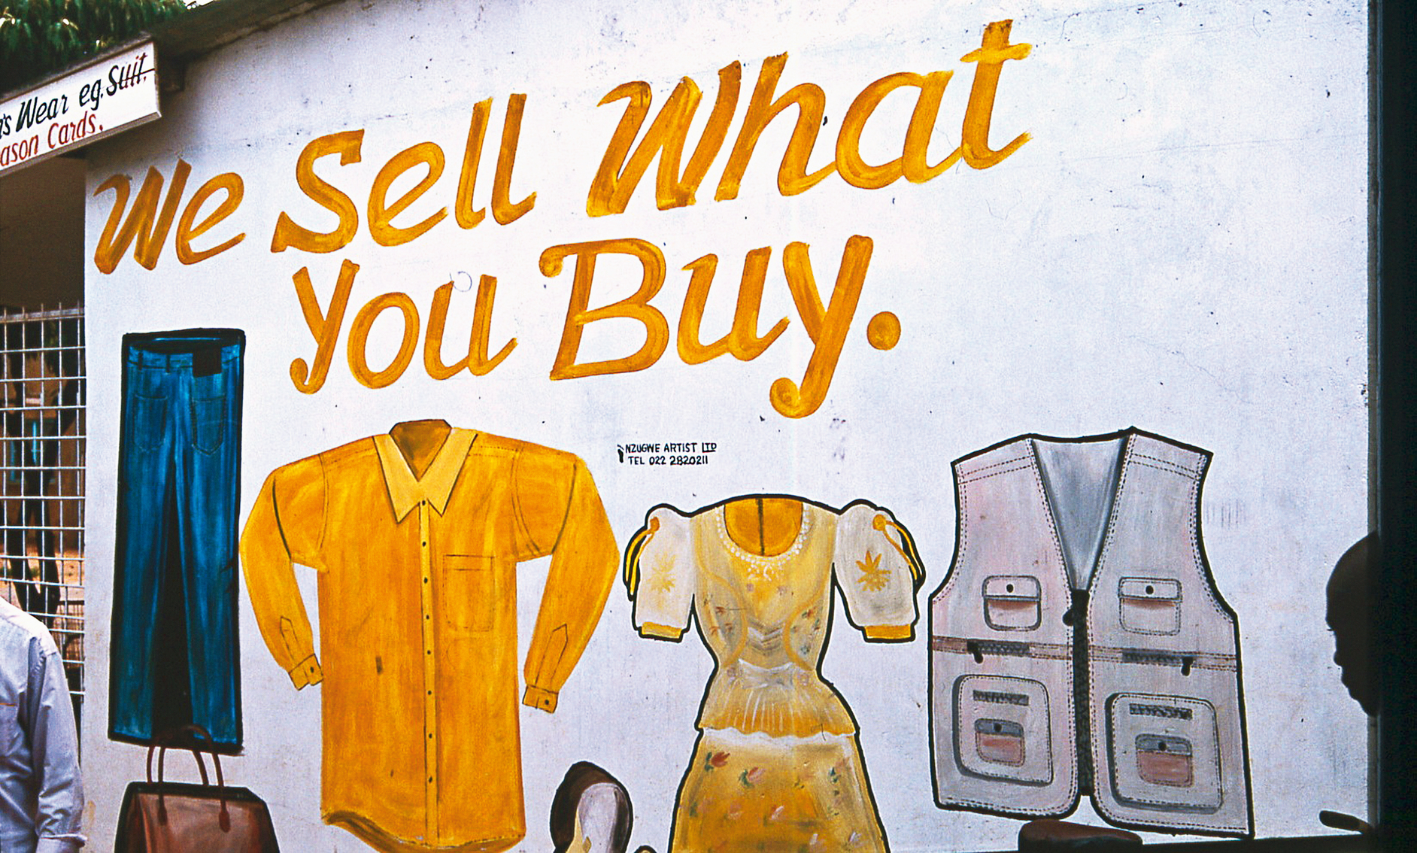
Thesis 7: Digital trade (e-commerce, trade with digital services increases significantly
Notes:
Thesis 7: Digital trade (e-commerce, trade with digital services) is increasing enormously
The process of digital transformation includes production in the narrower sense as well as logistics and industry-related services. The increasing complexity of the value creation and logistics chain, simplified interface management, intelligent infrastructure and the IT-supported merging of traffic and goods flows will result in a substitution of production mobility through digitization and new logistics concepts and make investment concepts of the 20th century appear uneconomical. The COVID-19 pandemic has made this clear once again. Digital trade accounts for an increasing share of total trade flows. This plays a significant role as digital commerce makes it easier for consumers and producers to find each other and often helps to reduce transaction costs. This opens up additional business opportunities for SMEs in particular. This also facilitates the integration of the world market. The conditions for the involvement of broad sections of the population in the production of digital services are at least not made more difficult. For climate-neutral development, the mobility sector is the most important and least transformed sector in terms of CO2 emissions to date, although the technologies are available.
Standards / Framework conditions for e-commerce
- Project: Pan-African E-Commerce Initiative
o Supporting the Smart Africa Alliance in initiatives to design a harmonised policy framework for a common digital market on the African continent, e.g. Blueprint developed to harmonise the framework conditions for electronic payment systems
- Project: African Continental Free Trade Area (AfCFTA)
o Strengthening the framework conditions for the implementation of the Pan-African Free Trade Area, including technical and procedural advice for policy-making at continental and/or member state level and for the negotiations on digital trade and e-commerce within the framework of the AfCFTA
Standards for Online Trade / Digital Trade - Consumer Protection
- Project example: Consumer protection in ASEAN (ASEAN PROTECT)
- "Supporting ASEAN in the development and implementation of regionally harmonised framework conditions for consumer protection in e-commerce. On the one hand, at the regional level, the responsible sector body ASEAN Committee on Consumer Protection (ACCP) is supported in the implementation of priority initiatives from the ASEAN Strategic Action Plan on Consumer Protection (ASAPCP), for example in the formulation and dissemination of guidelines, handouts, studies and learning materials. On the other hand, in selected ASEAN Member States (AMS), relevant actors from government, the private sector and civil society are sensitized to the opportunities and risks in regional and online trade and enabled to better protect consumer interests and rights.

Slide 12
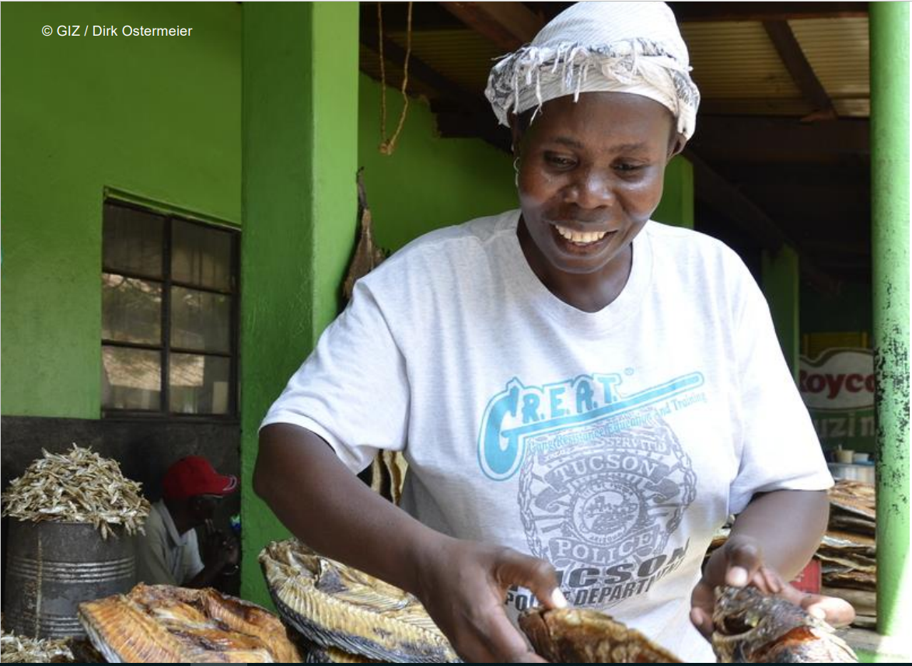
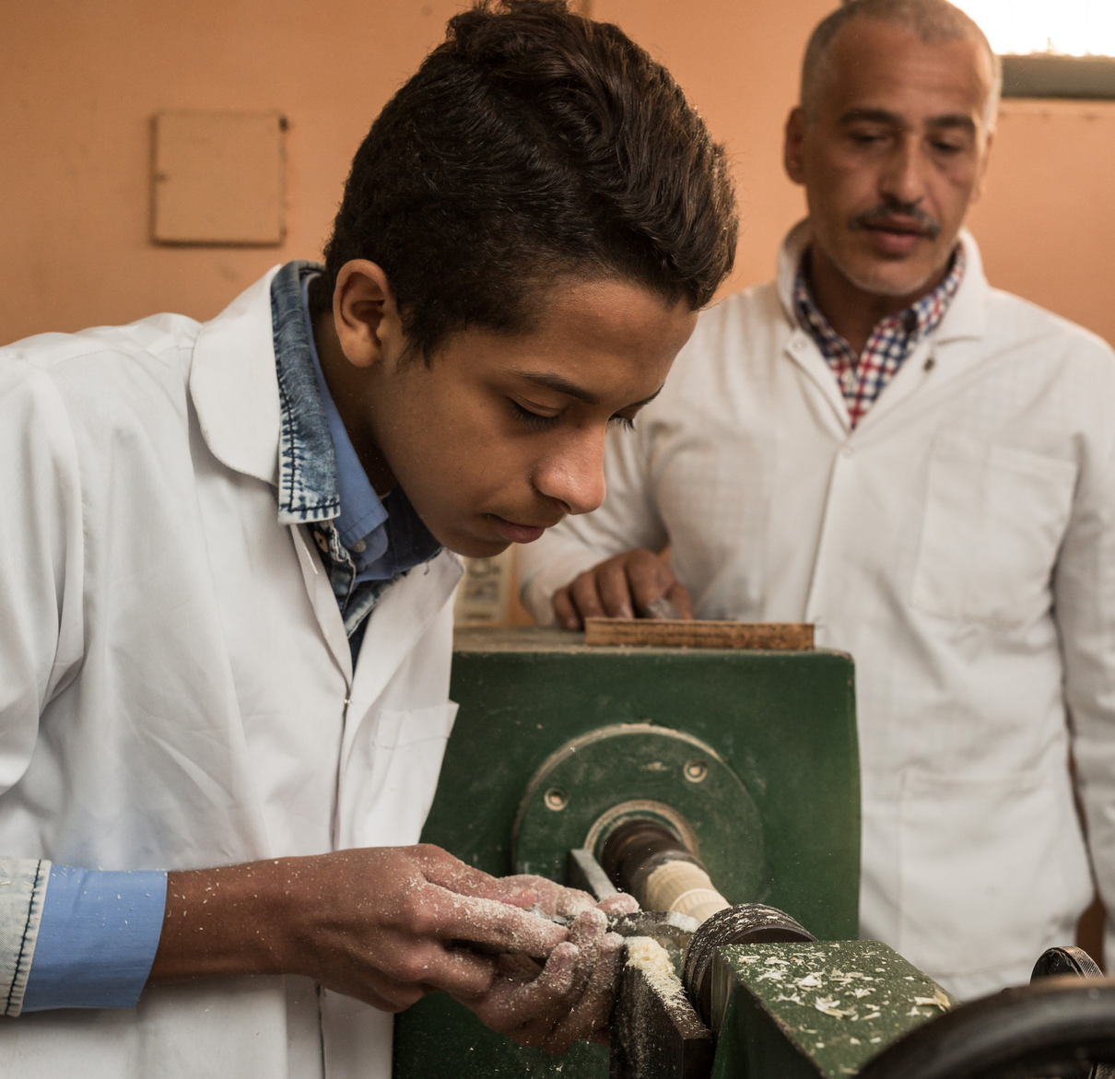
Thesis 8: In the digital age, poverty is no longer acceptable
Notes:
Thesis 8: Poverty is no longer acceptable in the digital age
The aim of the economy is not to leave anyone behind in poverty and to generate a parliamentary defined, at least acceptable prosperity for all. The cause of poverty today is not an absolute shortage, but insufficient distribution. This is no longer acceptable in the digital age. This results in national and international obligations for all governments to redistribute. In order for a redistribution to the poor to take place fairly and democratically legitimized, it is necessary to accurately record wealth data. Unlike income data or goods turnover or commodity trade flows, these data are not collected in most countries and for most asset categories, which is a policy decision. Parliaments, tax authorities and statistical offices must ensure the full availability of asset data, in particular financial capital. This is technologically possible without any problems, as the recording of financial transactions for the levy of withholding tax proves.

Slide 13

Thesis 9: Digitalization should help to keep development within earth‘s carrying capacity
Notes:
Thesis 9: Digitalization should help to comply with planetary load limits
Our current economic system crosses several planetary limits at the same time. The "new" digital way of thinking should not only provide a better explanation of the world, but also help solve these real problems. Among other things, the decoupling of economic growth and energy consumption is required. Digitalization and artificial intelligence (AI) are indispensable to achieve this goal. There is evidence that information and communication technology alone can achieve up to a 20% reduction in global CO2 emissions from 2015 levels in 2030 alone, according to the World Bank in 2020. So, what could be more obvious than to apply these tools quickly and on a grand scale to the most pressing challenges this civilization has ever faced? The Scientific Advisory Board on Global Environmental Issues (WBGU) has soberly stated that the digitalization of the economy and everyday life has so far only been marginally oriented towards sustainability aspects. So far, the digital resources and projects have mainly been used for conventional growth in established markets in international competition. The World Bank also sees the need to use digitalization for a sustainable climate policy: it calls for a digital transformation to unleash the transformative power of digital technologies, both for emission reduction and resilience across all sectors and to reduce the large and growing emissions of the digital sector itself.

Slide 14

Thesis 10: AI can support a strategy of leaving climate critical fossil fuels unexplored
Notes:
Thesis 10: AI can help to leave climate-damaging raw materials in the soil
In particular, energetic fossil raw materials, but also other scarce raw materials, are faced with the decision to be left in the ground at least partially in order not to overstrain capacities and slow down climate change. Artificial intelligence should be used here for optimization strategies. It is difficult to predict at what technological speed the "peak" of important resources on Earth will lead to a substitution by less scarce or renewable resources. On the other hand, it is clear that the still growing consumption of energy and raw materials (especially due to growth in the emerging countries) with the help of digitization and artificial intelligence makes the implementation of concepts for resource and energy saving (including recycling and secondary electricity use) more efficient and this can therefore be more easily enforced.

Slide 15
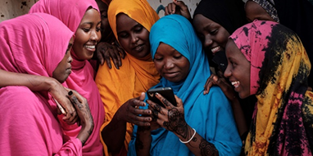
Thank you for listening!
Dr. Rainer Engels
Sectoral Program on Sustainable Economic Development
Deutsche Gesellschaft für
Internationale Zusammenarbeit (GIZ) GmbH
Friedrich Ebert Allee 32
53113 Bonn
Deutschland / Germany
T +49 228 4460-3784
M +49 151 46534907
E rainer.engels@giz.de
S rainer.engels
I www.giz.de

